Slide 1
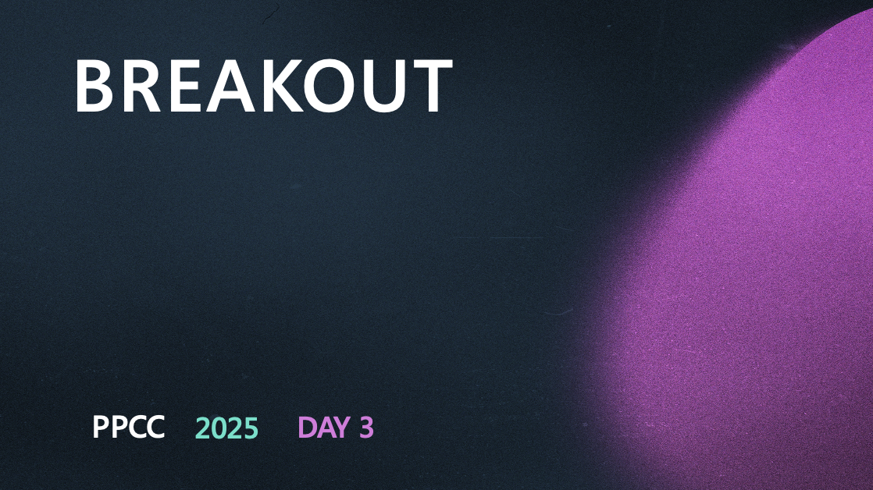
Advanced PCFs for Power Pages
Charles Channon and Garrett Pierce
Developers

Slide 2
ADVANCED PCFS FOR POWER PAGES

Slide 3
GARRETT PIERCE
Dev, 5 years in Power Platform
Avid rabbit hole explorer
Love to see how far I can push Power Pages

Slide 4
CHARLES CHANNON
Dev, architect, small biz owner
PPlat since CRM 4.0 (Dev since 2011) 10x Super User recognition (Power Apps, Power Pages, Power Automate)
MVP (Power Apps and Power Pages)

Slide 5
INTRODUCTION TO PCFS IN POWER PAGES
WHAT ARE PCFS AND WHY USE
THEM IN POWER PAGES?
Notes:
- Scalability
- To hell with jQuery
- Good architecture/separation of concerns
- Better subgrid handling
- WebAPI access vs writing fetch by hand
Welcome, everyone! In this session, we’ll dive deep into the world of PowerApps Component Frameworks (PCFs) and their advanced applications within Power Pages. Whether you’re a developer, architect, or solution designer, you’ll gain a comprehensive understanding of how PCFs can elevate your Power Pages projects.
We’ll explore a range of advanced use cases, examining both the technical details and the strategic decisions behind each approach. You’ll see real-world examples, learn about the pros and cons of different techniques, and walk away with practical insights you can apply to your own solutions.
This is a hands-on, technical session—expect code samples, architectural diagrams, and candid discussions about what works (and what doesn’t) in the field. By the end, you’ll be equipped to make informed choices and push the boundaries of what’s possible with Power Pages and PCFs.

Slide 6
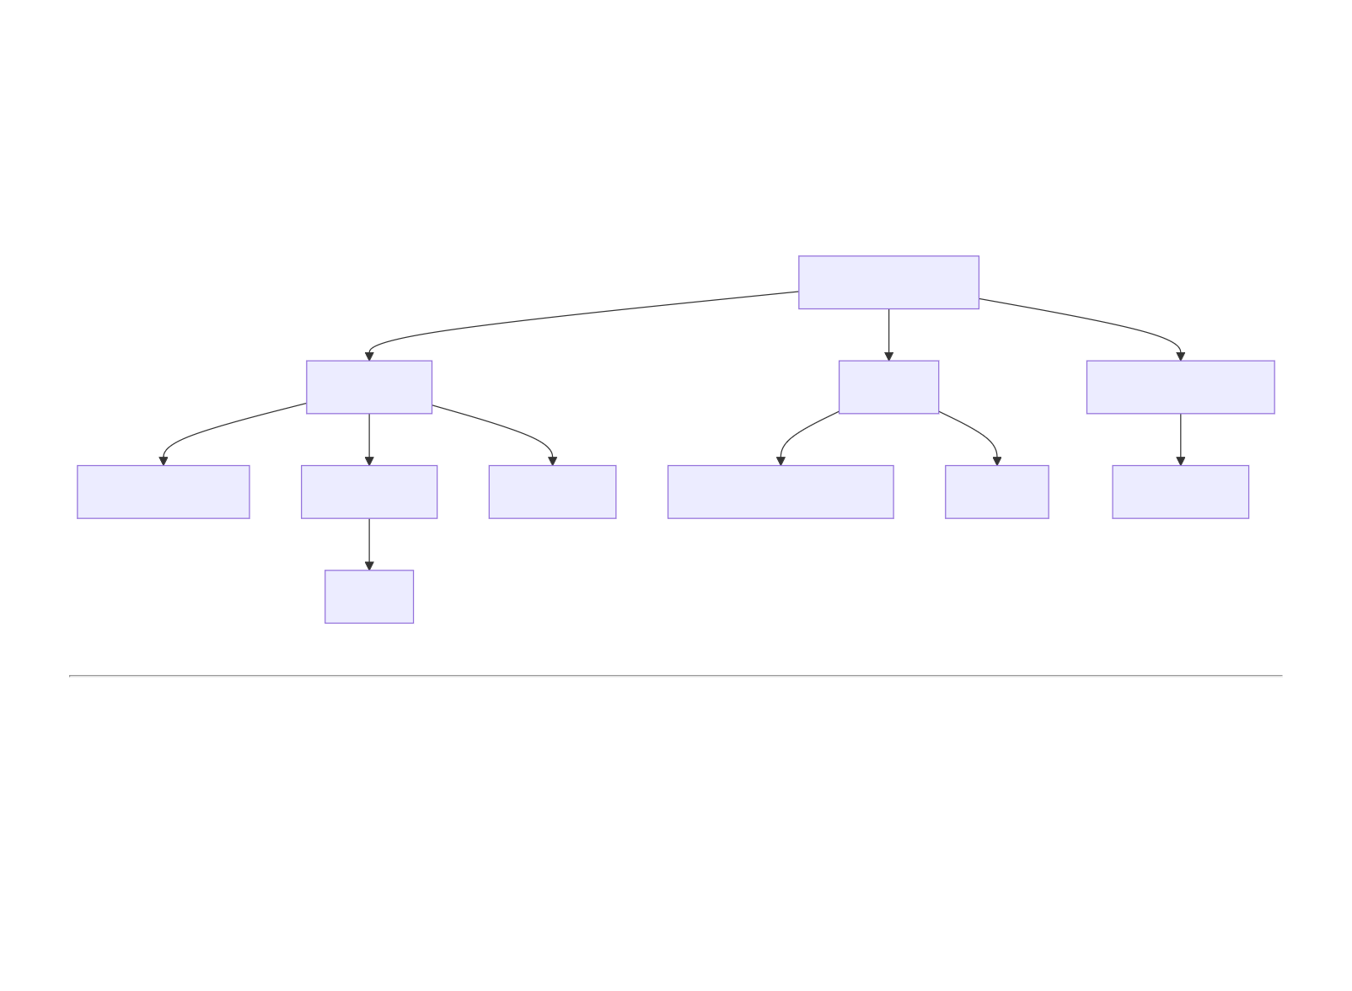
PCF Component
Manifest
Code
Solution Package
I/O Definitions
Resources
Features
TypeScript/JavaScript
HTML
Dataverse
CSS

Slide 7
BASIC BUILDING & PACKAGING STRATEGIES
VIRTUAL VS. VANILLA PCF

Slide 8
VIRTUAL
Virtual components utilize the React and Fluent libraries within the platform to work. This leads to much smaller PCF bundles.

Slide 9
VANILLA (STANDARD)
Vanilla components do not include React by default. You can include React in a standard component, but it turns into a headache of version management pretty quickly.

Slide 10
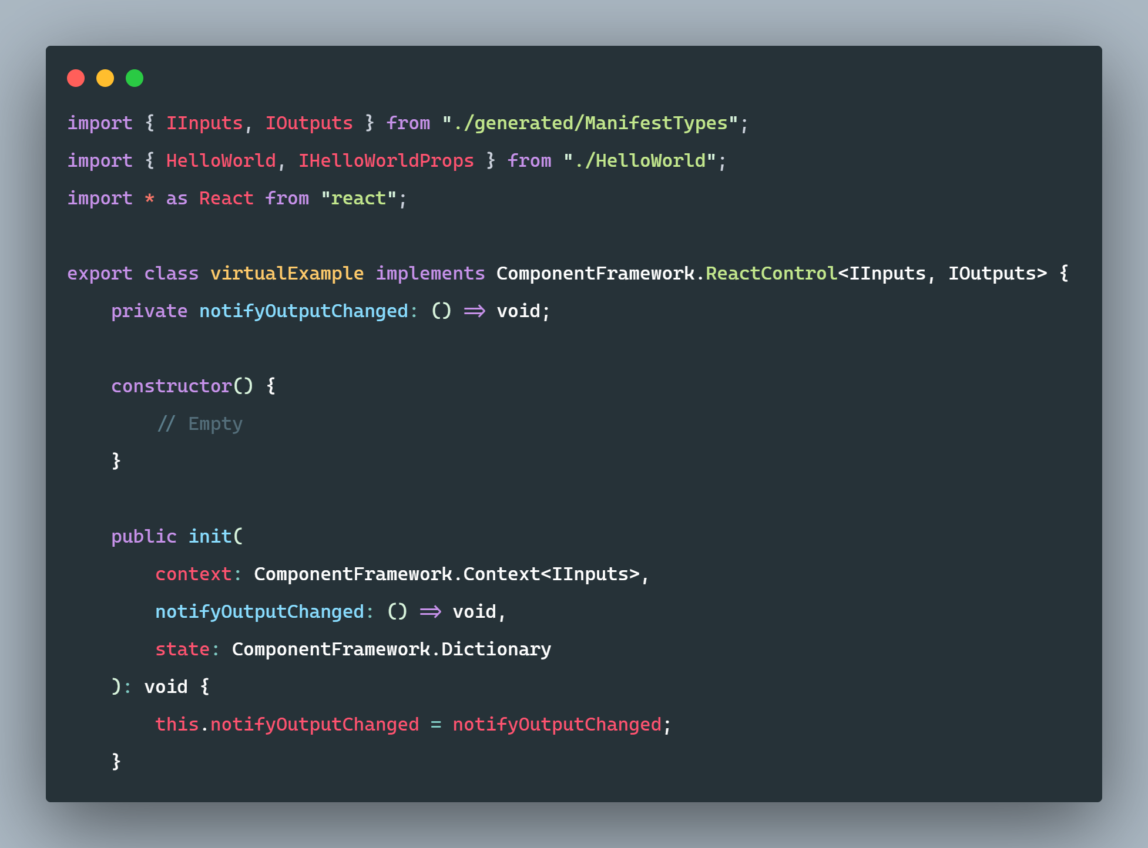
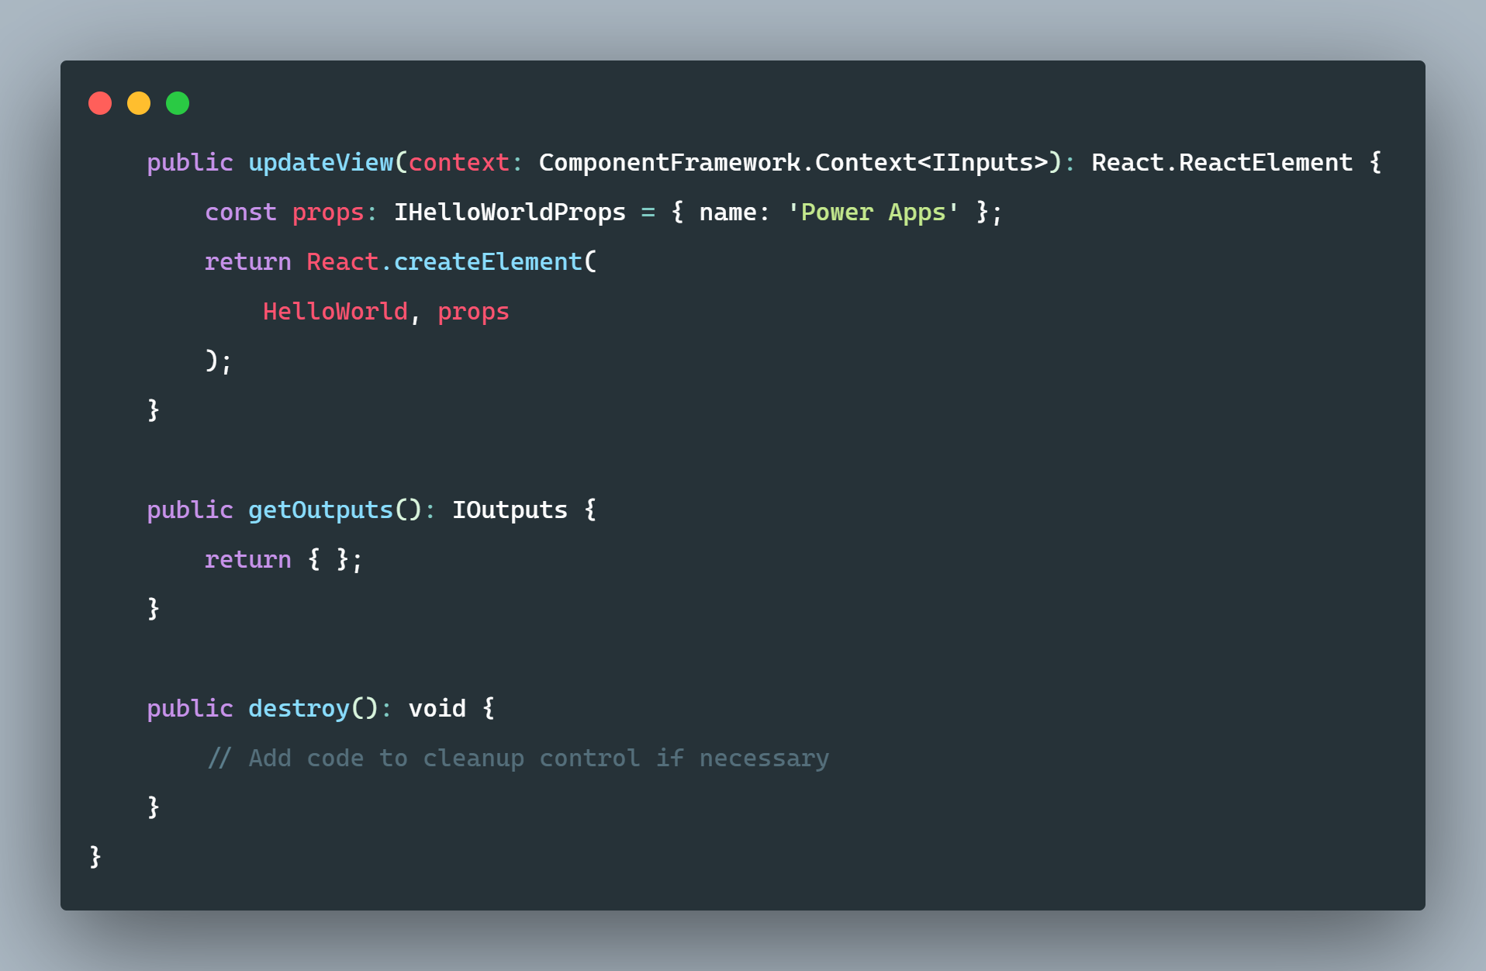
SAMPLE CODE: VIRTUAL PCF
index.ts for virtual example

Slide 11
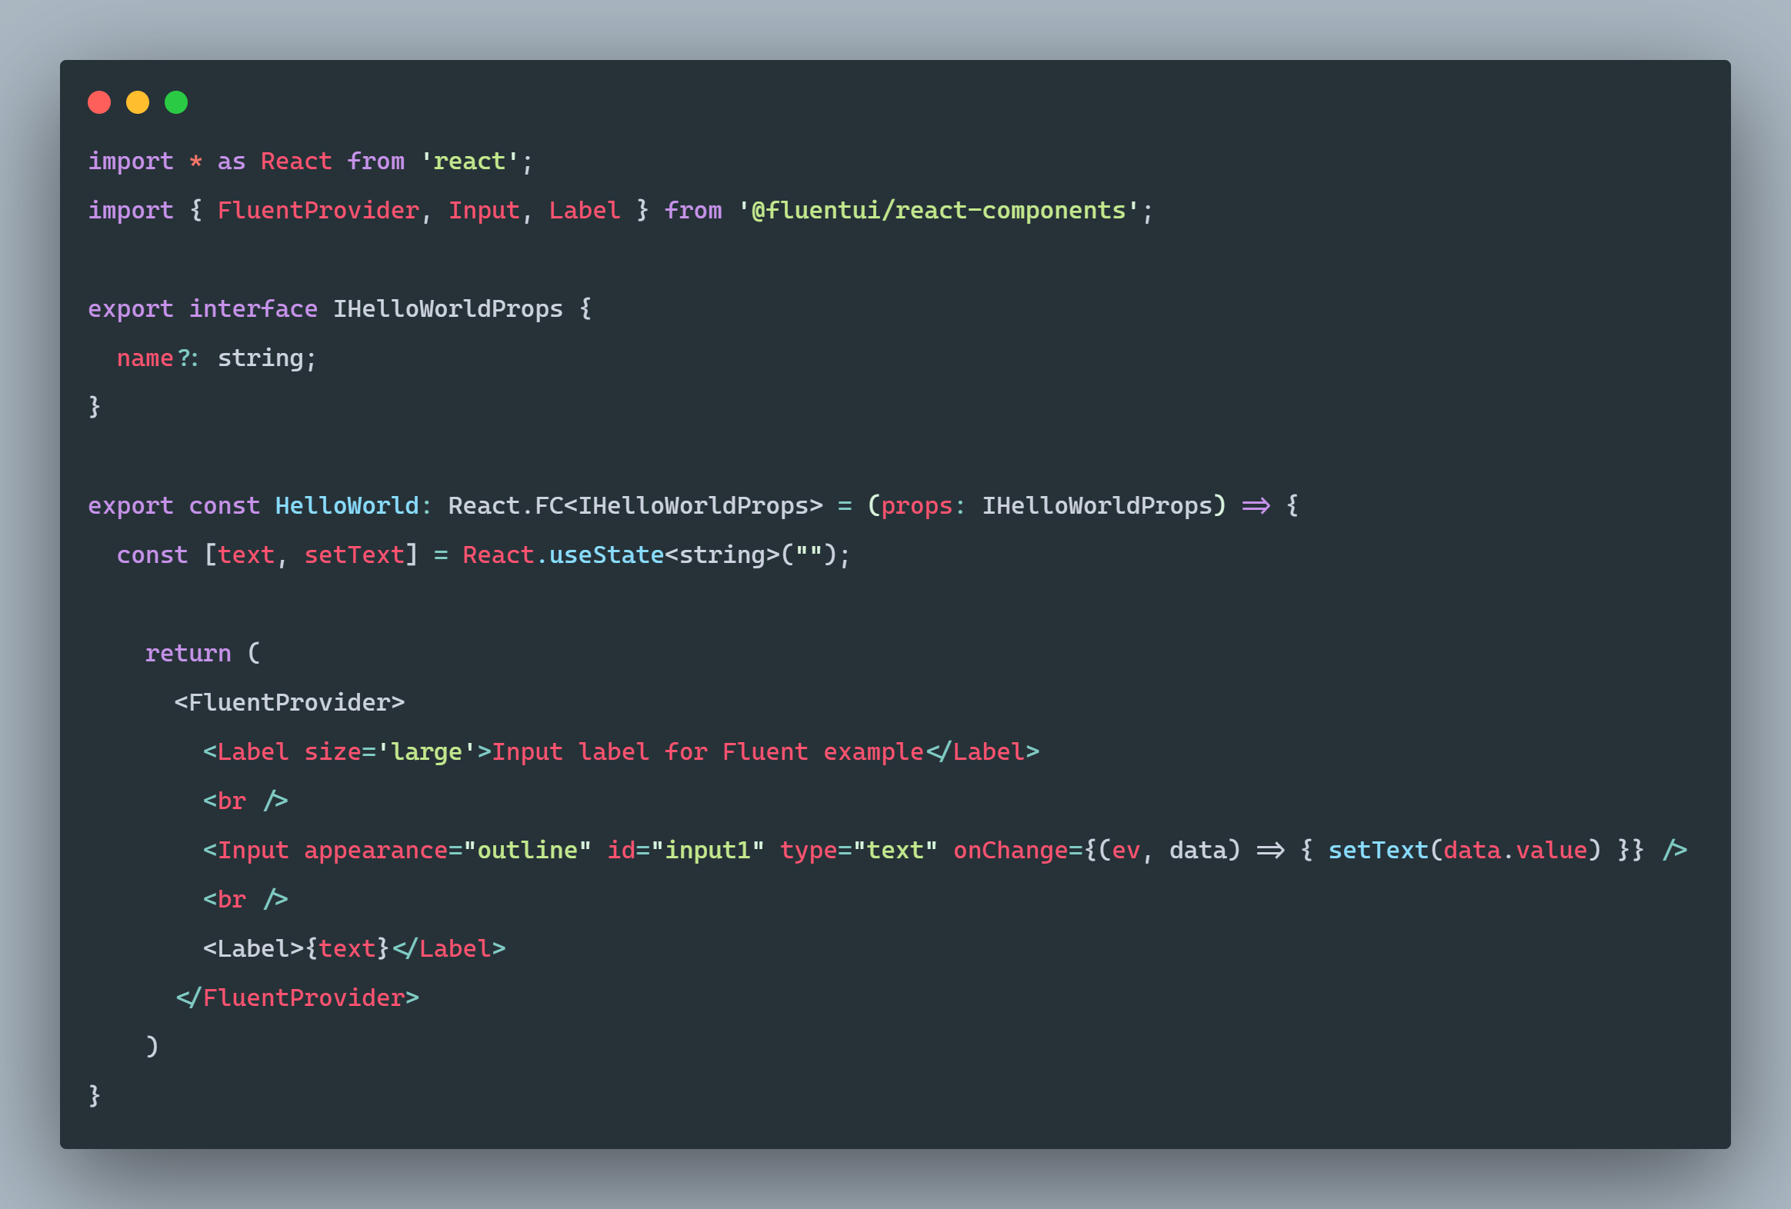
HelloWorld.tsx for virtual example

Slide 12
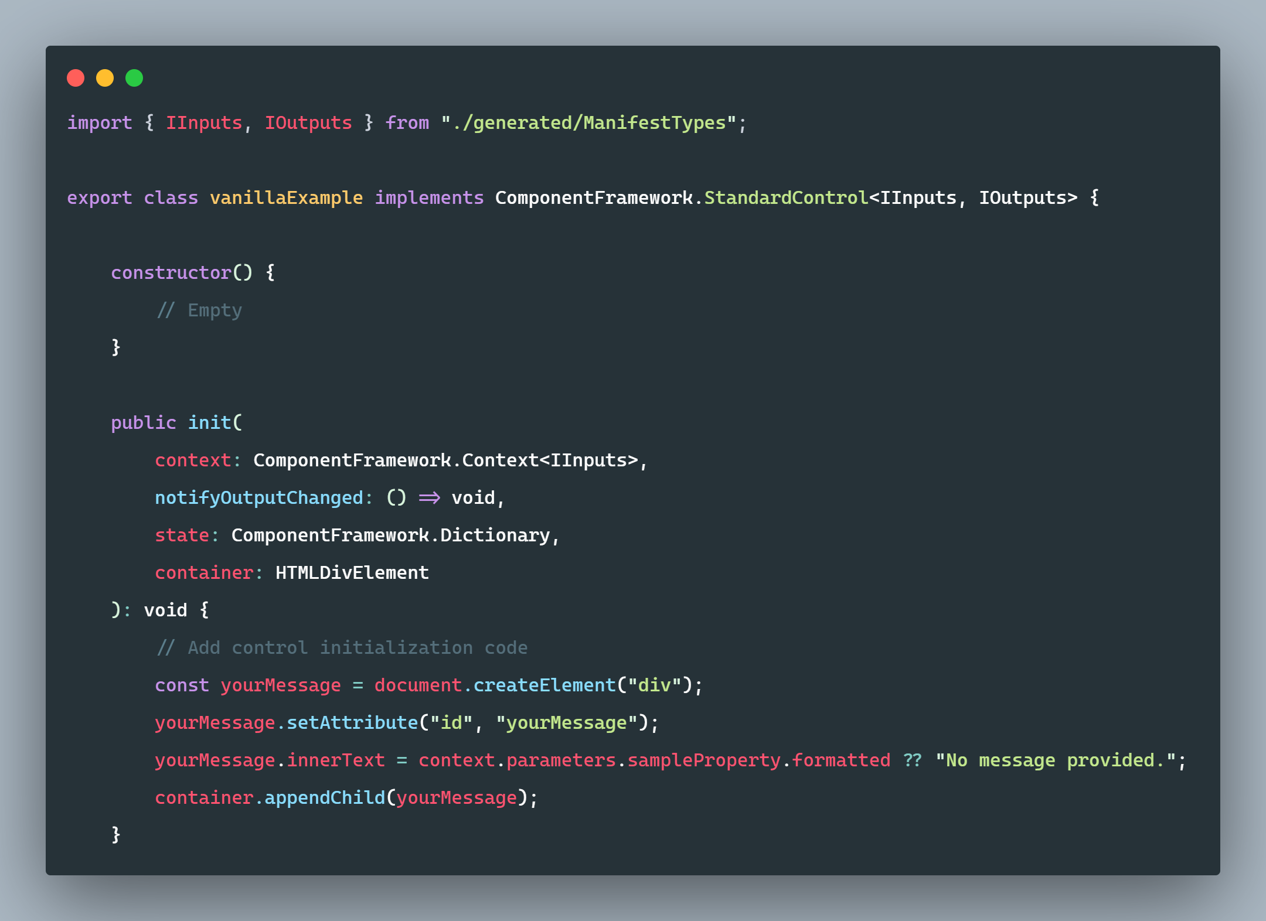
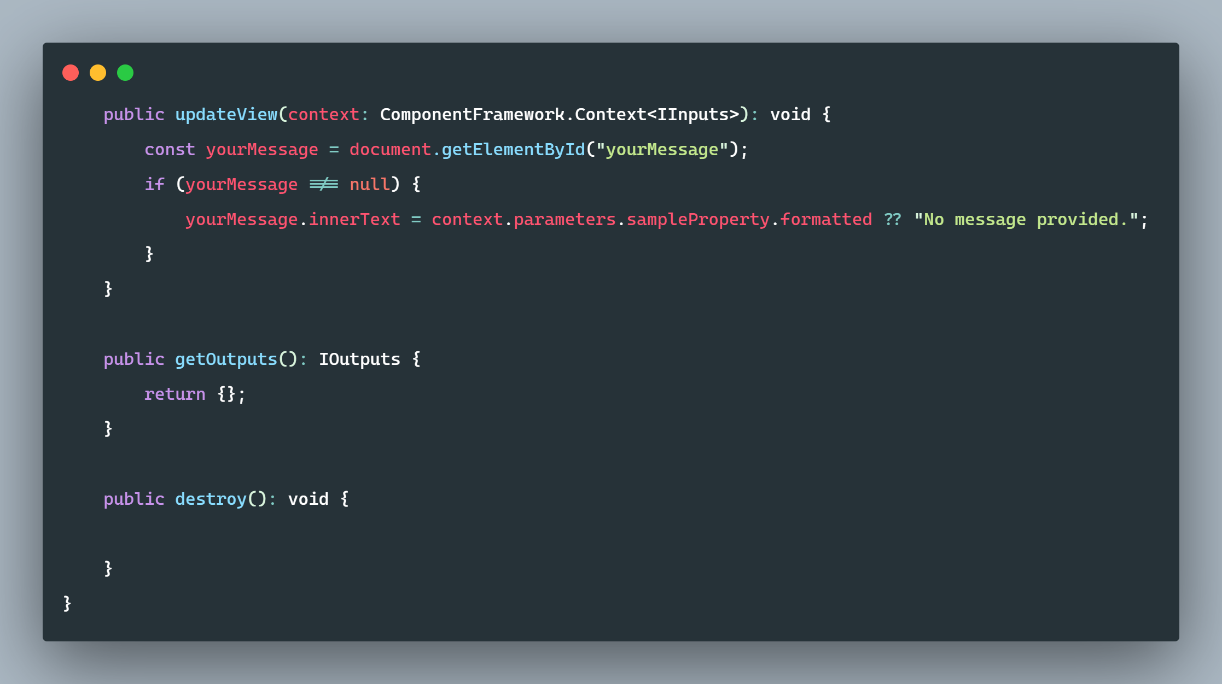
SAMPLE CODE: VANILLA PCF
index.ts for vanilla PCF example

Slide 13
FORCING REACT BUNDLING
When we submitted the abstract for this presentation, it was necessary to force React into your virtual component bundle through "npm install --save react" in order to have it function on a Power Pages site
However this no longer seems to be the case, an out of the box virtual component can function on Power Pages without bundling React of Fluent UI.

Slide 14
BUILDING FOR POWER PAGES
As you don't have to force React or Fluent UI into your PCF bundle anymore, building PCF controls for Power Pages has become pretty easy.
You can simply initialize your component, write your code, build to a Power Apps solution, and import as you would any other PCF.

Slide 15
BASIC INTEGRATION METHODS
PCFS ON MODEL-DRIVEN APP FORMS AND HOW TO USE THOSE IN POWER PAGES

Slide 16
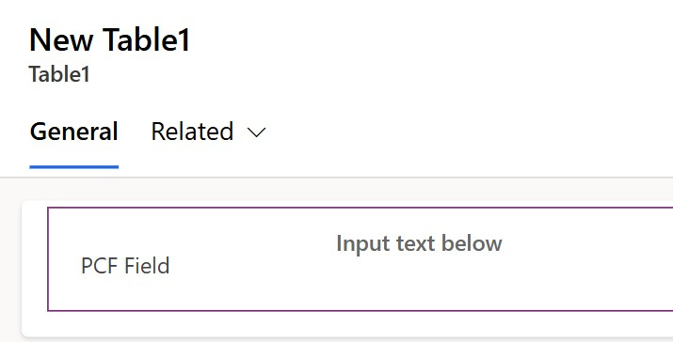
In this example, a PCF is tied to a simple field on a model-driven app form in the Power Apps form editor.

Slide 17
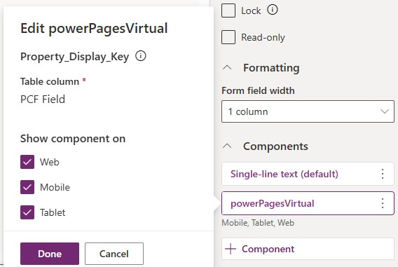
This is the relevant configuration for the PCF on the MDA form.

Slide 18
Once you're in the Power Pages editor, click the plus button within a section to add a component. That will bring up the following, and you'll click the Form option.

Slide 19
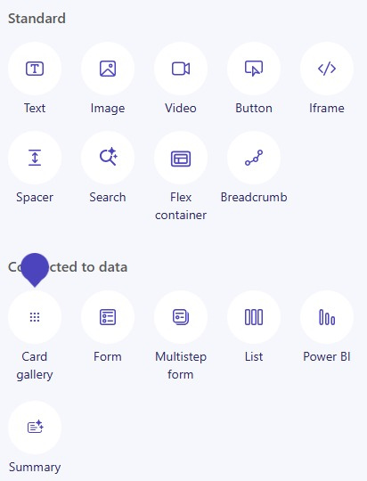

Slide 20
Clicking the Form option will bring up this dialog, you'll want to use New form.

Slide 21
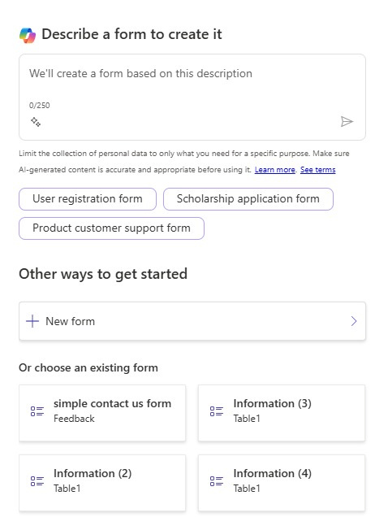

Slide 22
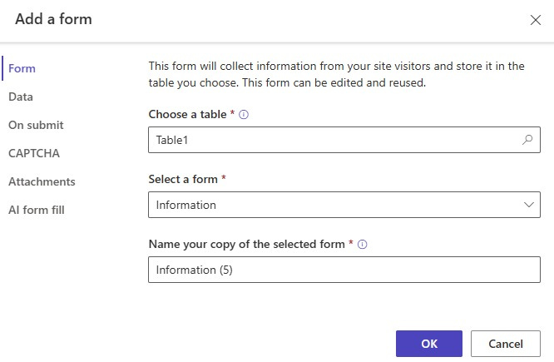
Which in turn will bring up this dialog. In our case for this example, we keep it fairly simple, we only need the Table, the Form, and a name for the Form within Power Pages.

Slide 23
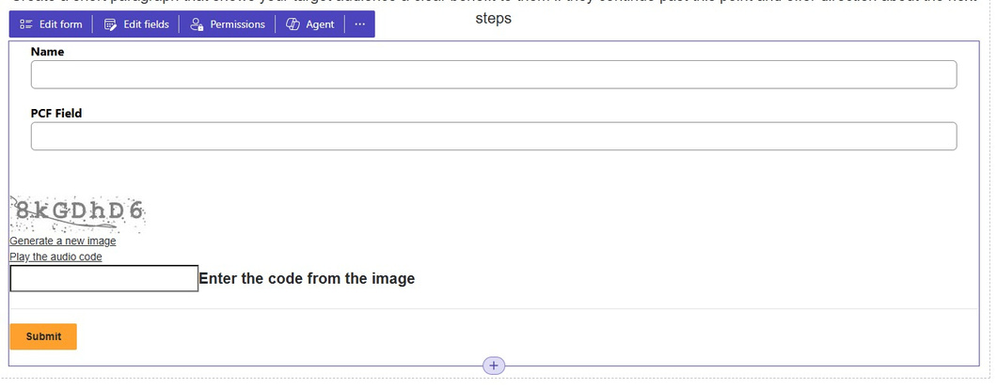
That makes the form available on your Power Pages site in the WYSIWYG editor. But you may notice that the field labeled PCF Field is just a simple text field, which doesn't look right.

Slide 24
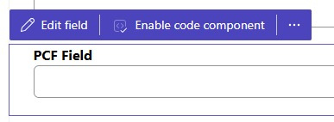
Click on the individual field and you'll be presented with these options. You need to enable the code component.

Slide 25
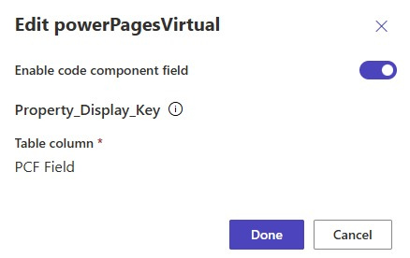
This is an example of the dialog that appears when you click Enable code component. Make any adjustments you may need to and click Done.

Slide 26
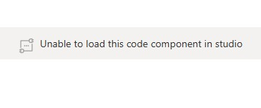
You will likely see this in place of the field you used for the code component. This doesn't mean there's an issue with your component, it just means that the WYSIWYG editor doesn't execute all the code necessary show your component.

Slide 27
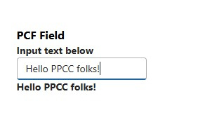
If you use the Preview button to look at your site, you should see your PCF as intended.
Our simple example takes the value from a text input and reactively displays that below the input.

Slide 28
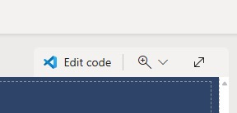
FORM EMBEDDING WITH LIQUID
Power Pages also uses the Liquid templating language behind the scenes, and devs can edit that code. There is a button in the WYSIWYG editor with the VS Code logo and label that reads "Edit code" that will take you to your site's code.

Slide 29
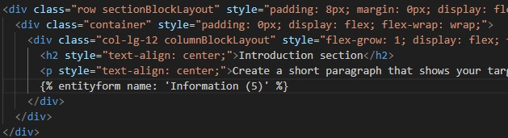
Once it loads, it should bring up the actual page you were on when you launched the editor. You can look through the onslaught of divs that comprises your page, and eventually find where your form is embedded.

Slide 30

The code that embeds your form in the page will look something like this:
{% entityform name: 'Information (5)' %}

Slide 31
LIMITATIONS OF FORM EMBEDDING
Embedding a fullform in your Power Pagessite
does come with limitations however. Your PCF will be tied to whatever form it's on, and will always reflect the context of the form around it. A PCF embedded in a form cannot be separated from the form. But you can use the PCF on its own in a Power Pages site.

Slide 32
EMBEDDING WITH LIQUID TAGGING
PCFs can be used on an individual basis on a
Power Pages site through Liquid tags. The codecomponent Liquid tag works with PCFs to bring PCFs in to a page without needing the PCF to be embedded on a form.

Slide 33
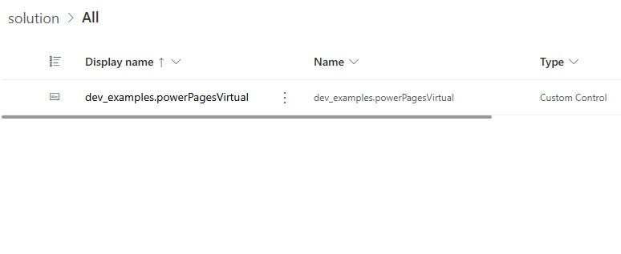
To do this, you'll need the name of the PCF component, seen here in the Name column:

Slide 34
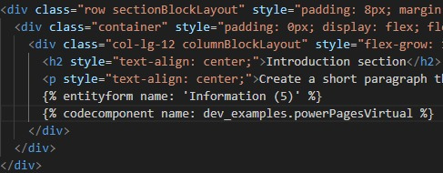
Then we'll embed it right below the form we embedded in the last example:

Slide 35
The code that embeds the PCF directly in Liquid will look something like this:
{% codecomponent name:
dev_examples.powerPagesVirtual %}
And if you need to provide a value to a property in your PCF, those are key/value pairs separated by a colon, like this:
{%codecomponent name:
dev_examples.powerPagesVirtual controlValue:'Here is a value' %}

Slide 36
Save the file in the code editor, then head back to the WYSIWYG editor and hit sync to make sure the changes from the code editor come through. And sure enough, it's there (seen below as the second "Unable to load this code component in studio" marker)!

Slide 37
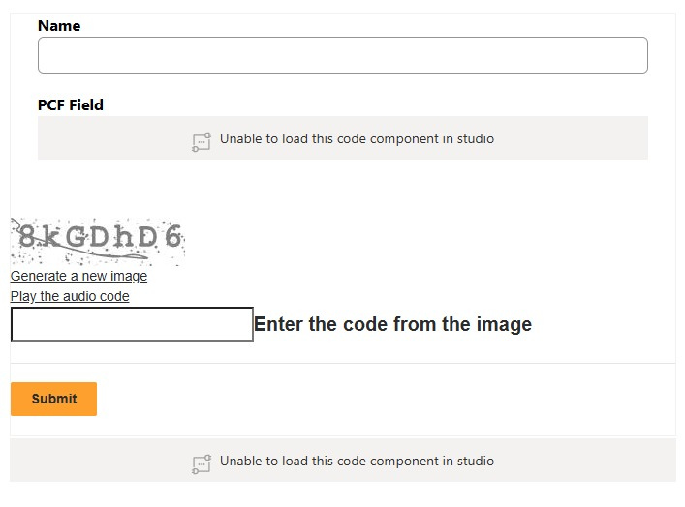

Slide 38
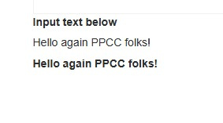
And here it is in the preview:

Slide 39
LIMITATIONS OF LIQUID TAG EMBEDDING
Code components embedded through Liquid tagging don't carry record context in the same way a PCF on a model-driven app form would You could provide a record to your PCF as a PCF parameter
Will not work in Web Templates

Slide 40
UI FRAMEWORK CONSIDERATIONS
FLUENT UI VS. BOOTSTRAP
Fluent UI | Bootstrap
Built by Microsoft | Built by Twitter
Adopts similar design language to what already exists in Power Apps | Platform-agnostic
Integrated with Microsoft Ecosystem | More broadly usable
Fluent components have issues in Liquid tagging | Power Pages uses Bootstrap internally

Slide 41
DEMO

Slide 42
FLUENT UI IMPLEMENTATIONS
Integrating Fluent UI is aseasy as adding --
framework react to your pac pcf init
command. Using that parameter ensures that React and Fluent UI are bundled with your component and ready for you to use.

Slide 43
SAMPLE CODE: FLUENT UI IMPLEMENTATION index.ts for Fluent example

Slide 44
HelloWorld.tsx for Fluent example

Slide 45
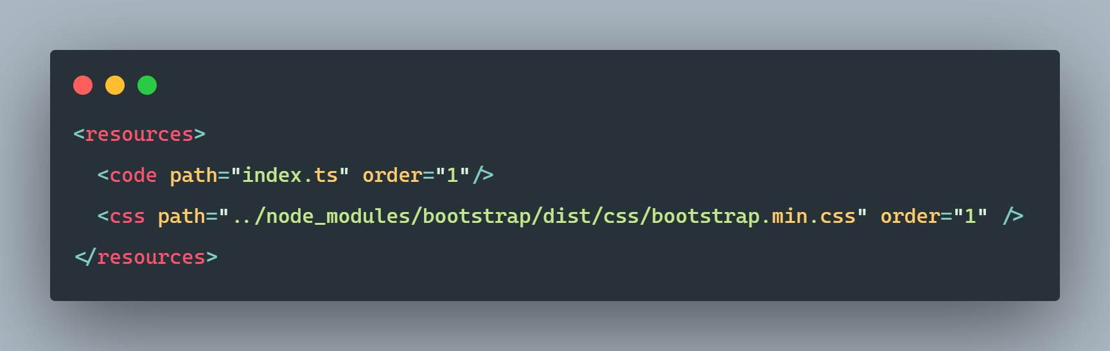
BOOTSTRAP IMPLEMENTATION
You need to use npm install bootstrap to make sure your project includes Bootstrap
Once that's done, you need to include it as a resource in ControlManifest.Input.xml

Slide 46
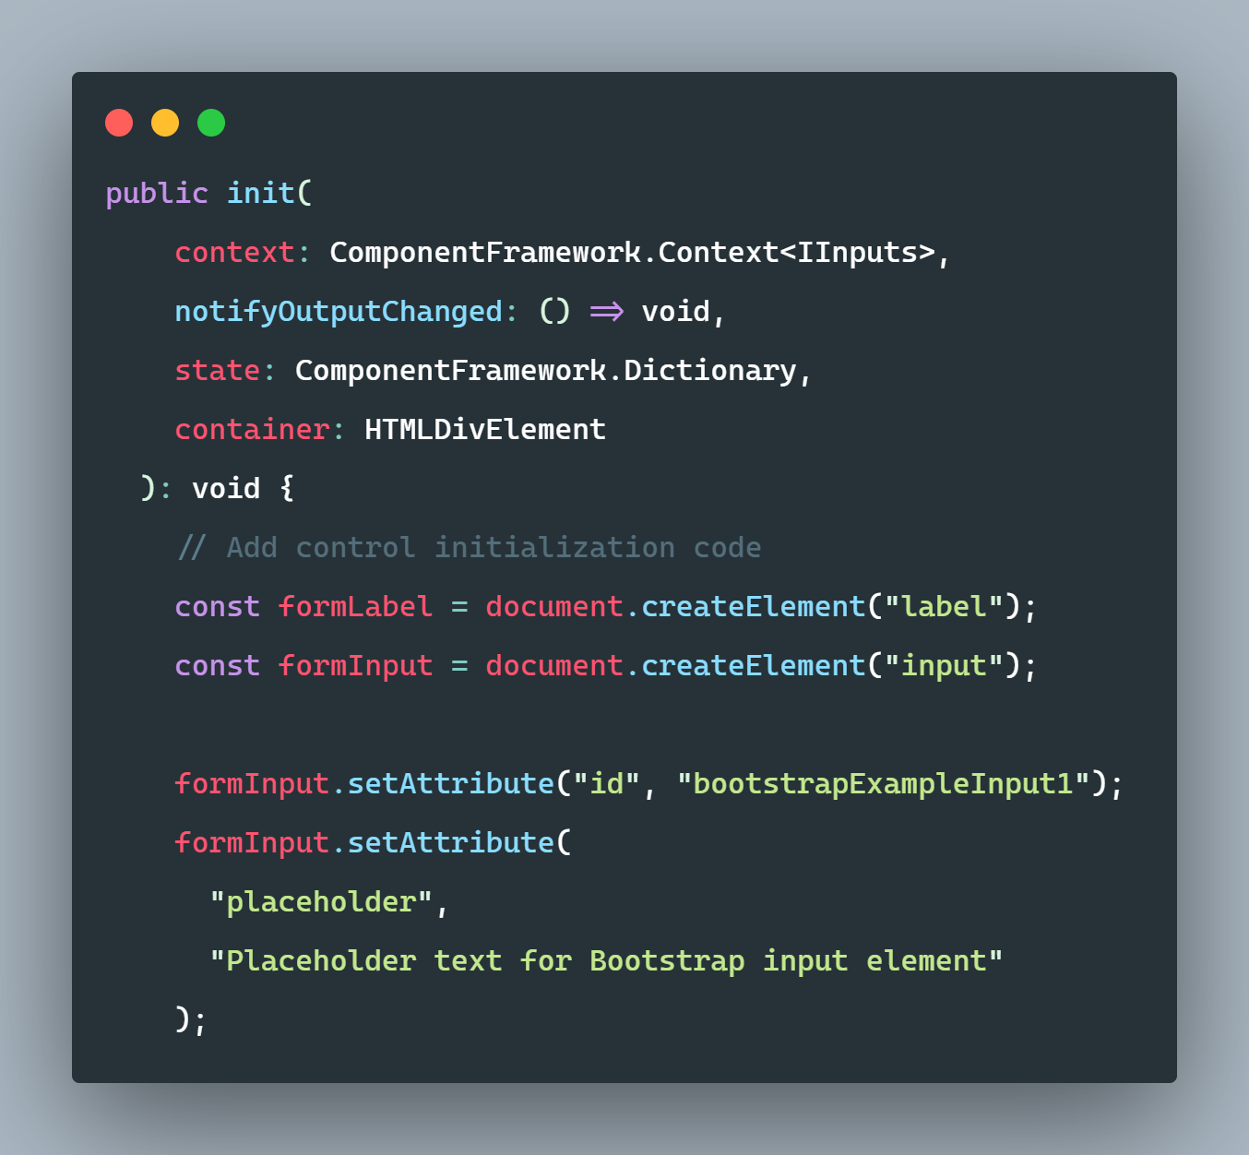
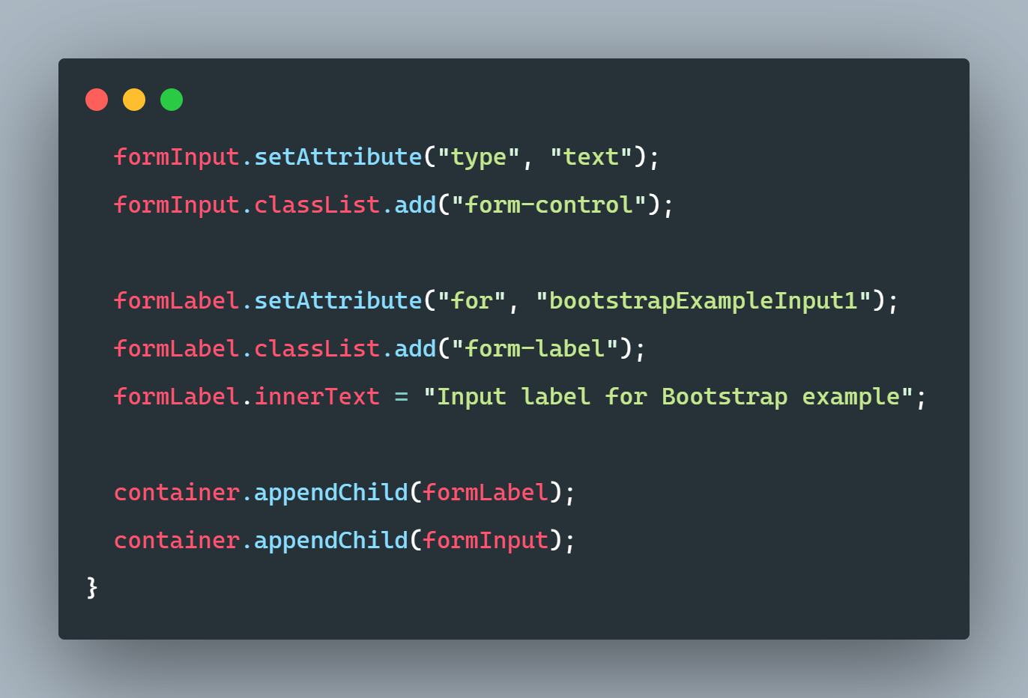
SAMPLE CODE: BOOTSTRAP IMPLEMENTATION

Slide 47
ADVANCED DATA MANAGEMENT TOPICS
PCFs come with specific limitations that can make it challenging to handle data in efficient ways. In particular, inter-control communication
The approaches that follow are not limited to Power Pages, but they are especially useful in a Power Pages context.

Slide 48
EXTENDING WEBAPI CAPABILITIES FOR GREATER MESSAGE ACCESS AND EFFICIENCY
The PCF WebAPI provides some helpful functions that cover basic use cases, but extended capabilities still need to be coded the old fashioned way...

Slide 49
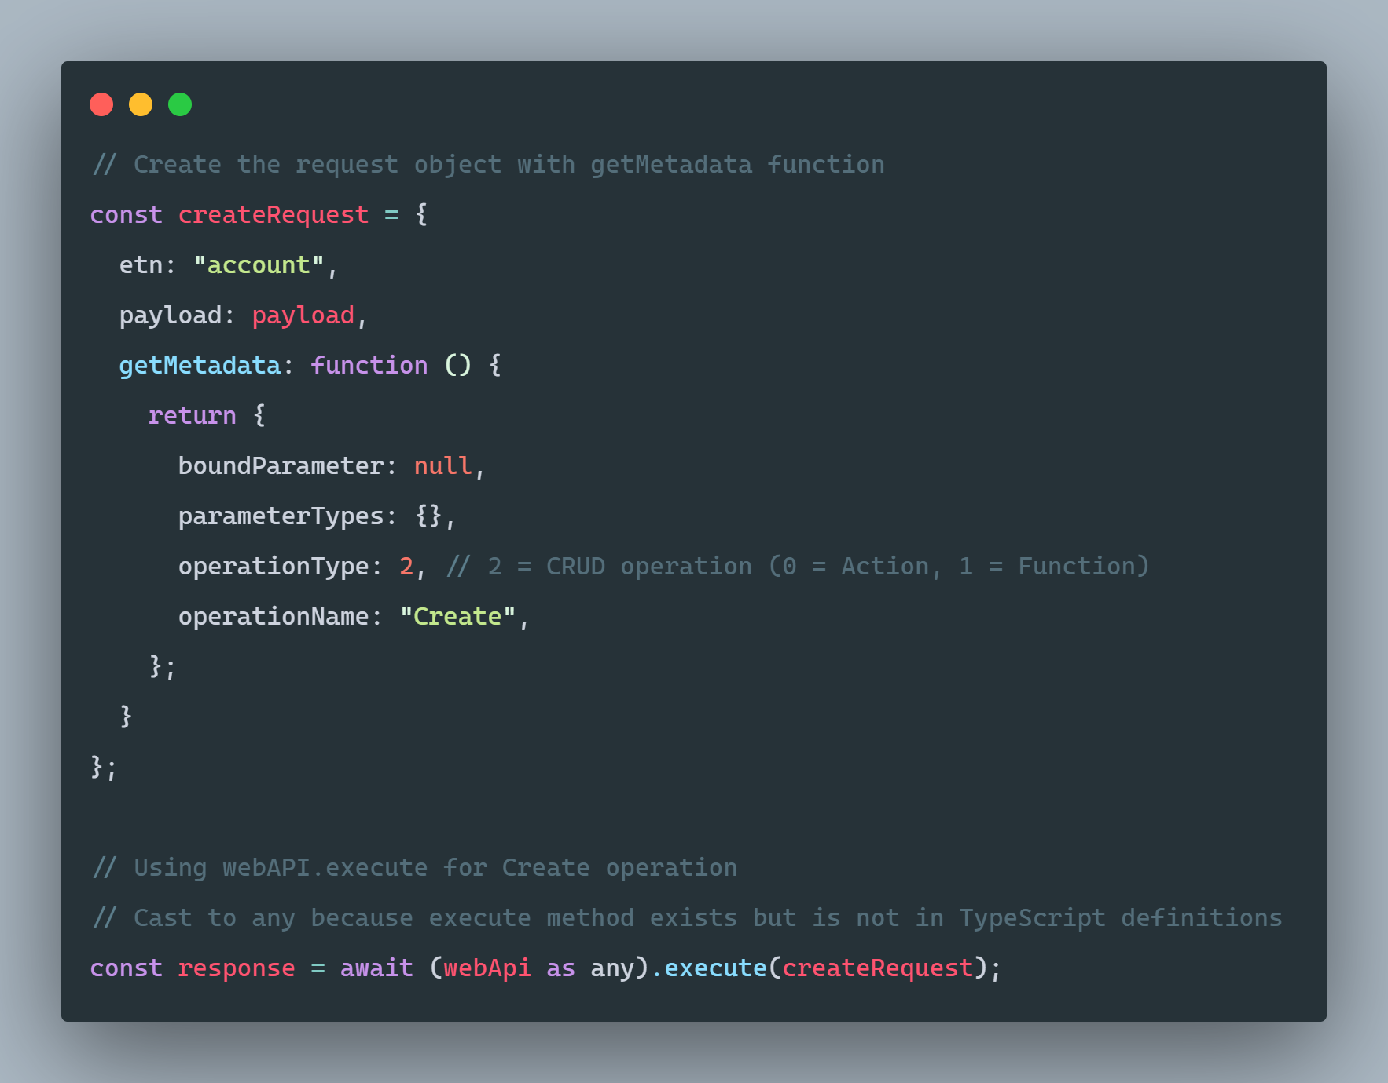
.EXECUTE()
Notes:
The execute method under webapi is not enumerated in the typescript classes and undocumented, so technically this is unsupported, but let's call it a "soft" unsupported because it follows the exact usage patterns of the Xrm webapi execute, so changes to it are almost impossible to imagine...
This can be used for a huge number of message types, including all API Functions and Actions (queueing, sharing, you name it!)

Slide 50
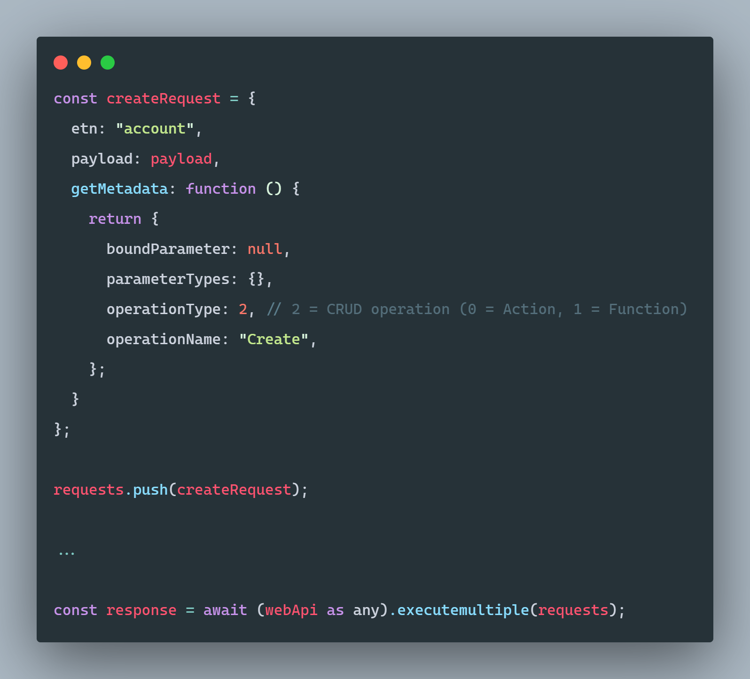
.EXECUTEMULTIPLE()
Notes:
The same is true of the ExecuteMultiple operation, exposed much the same way. This enables us to batch up an arbitrary number of requests, calling the API just once to handle all of them instead of nesting, multithreading, or any other approach. This is much more resource efficient and can greatly speed execution of large request batches...

Slide 51
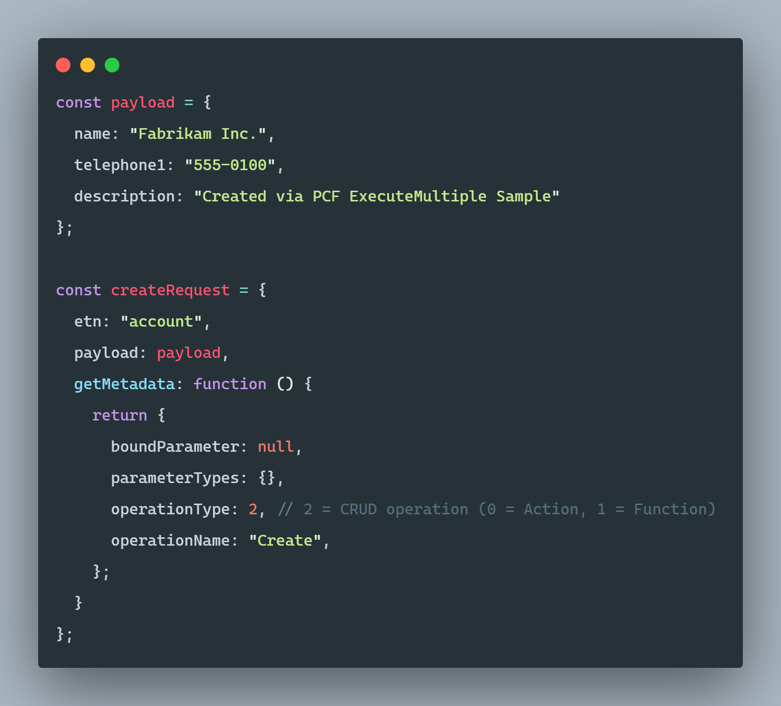
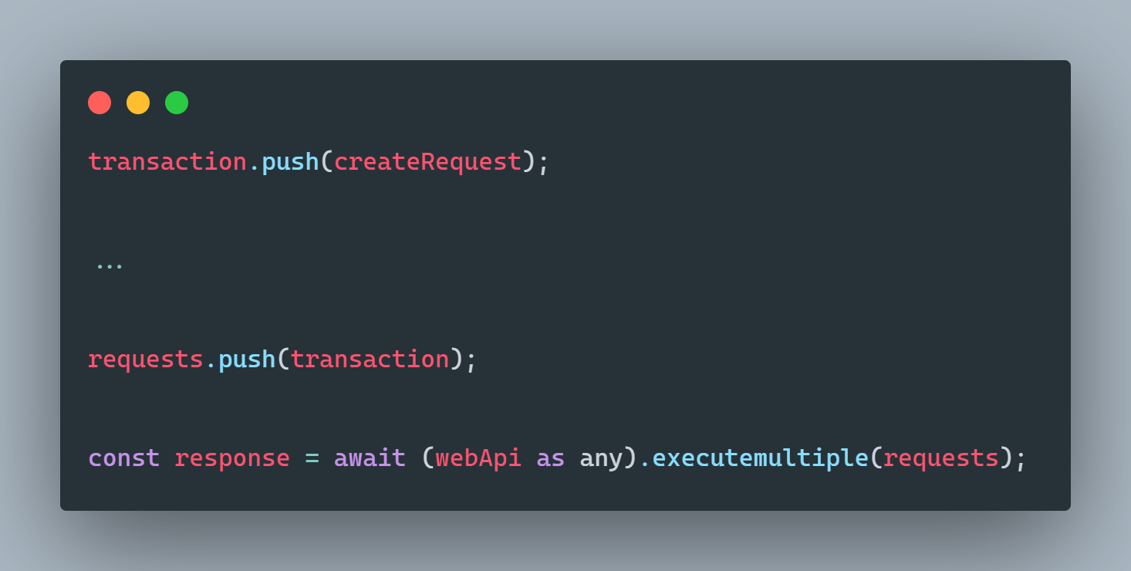
.BEASTMODE()
Notes:
Going even further, we can use executemultiple to not only bring efficiency to our parallel requests, but also to transaction-bind a request series, providing transaction backout safety in the event of individual transaction failure.

Slide 52
DEMO

Slide 53
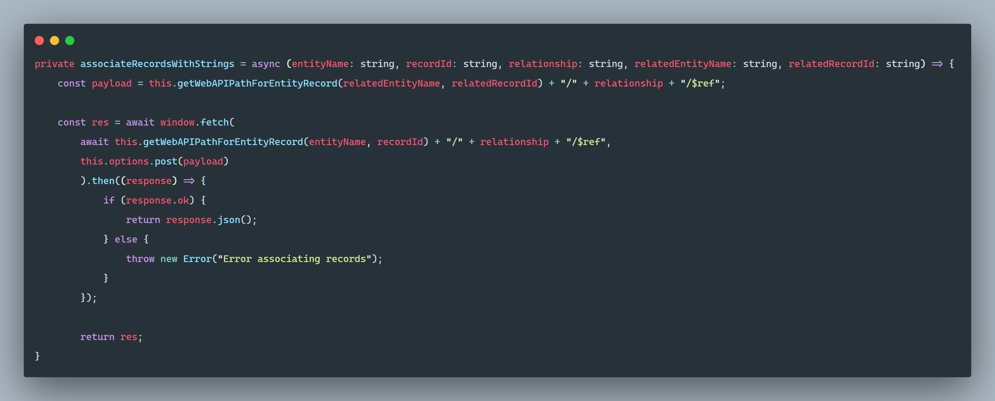
AND YES, WE CAN STILL DO IT WITHOUT .WEBAPI...

Slide 54
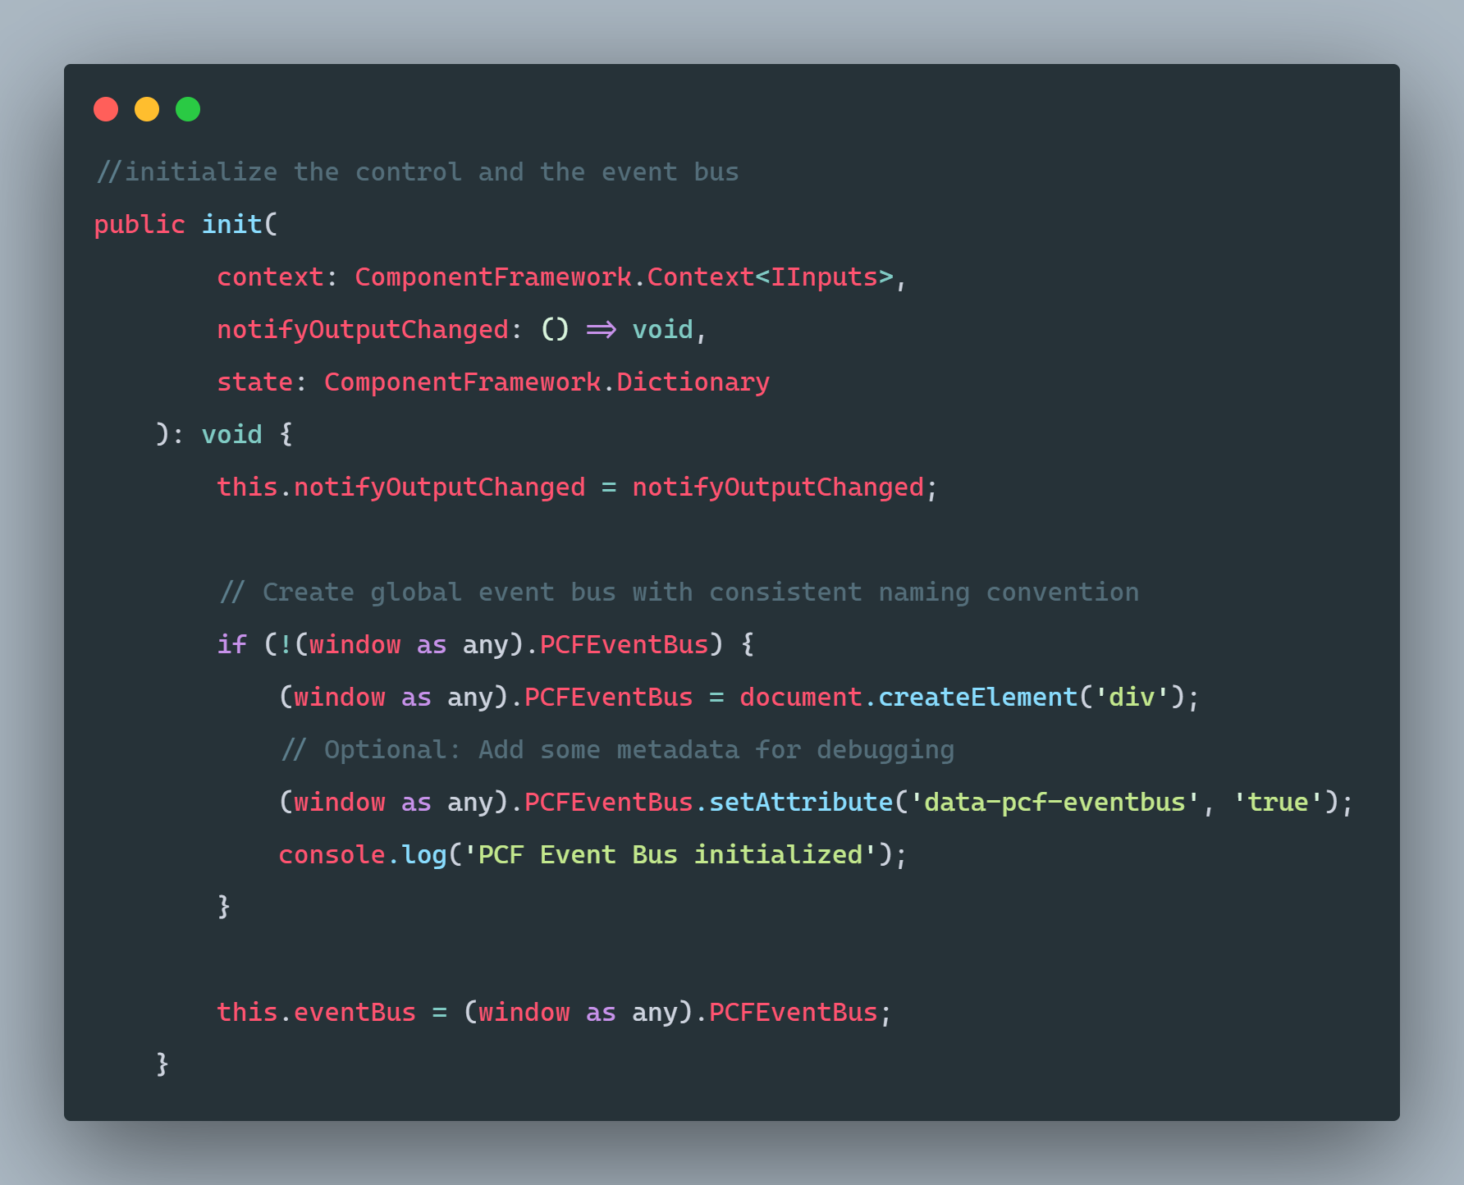
SAMPLE CODE: CROSS- COMPONENT COMMUNICATION
A SIMPLE EVENT BUS FOR CLIENT-SIDE EVENTS

Slide 55
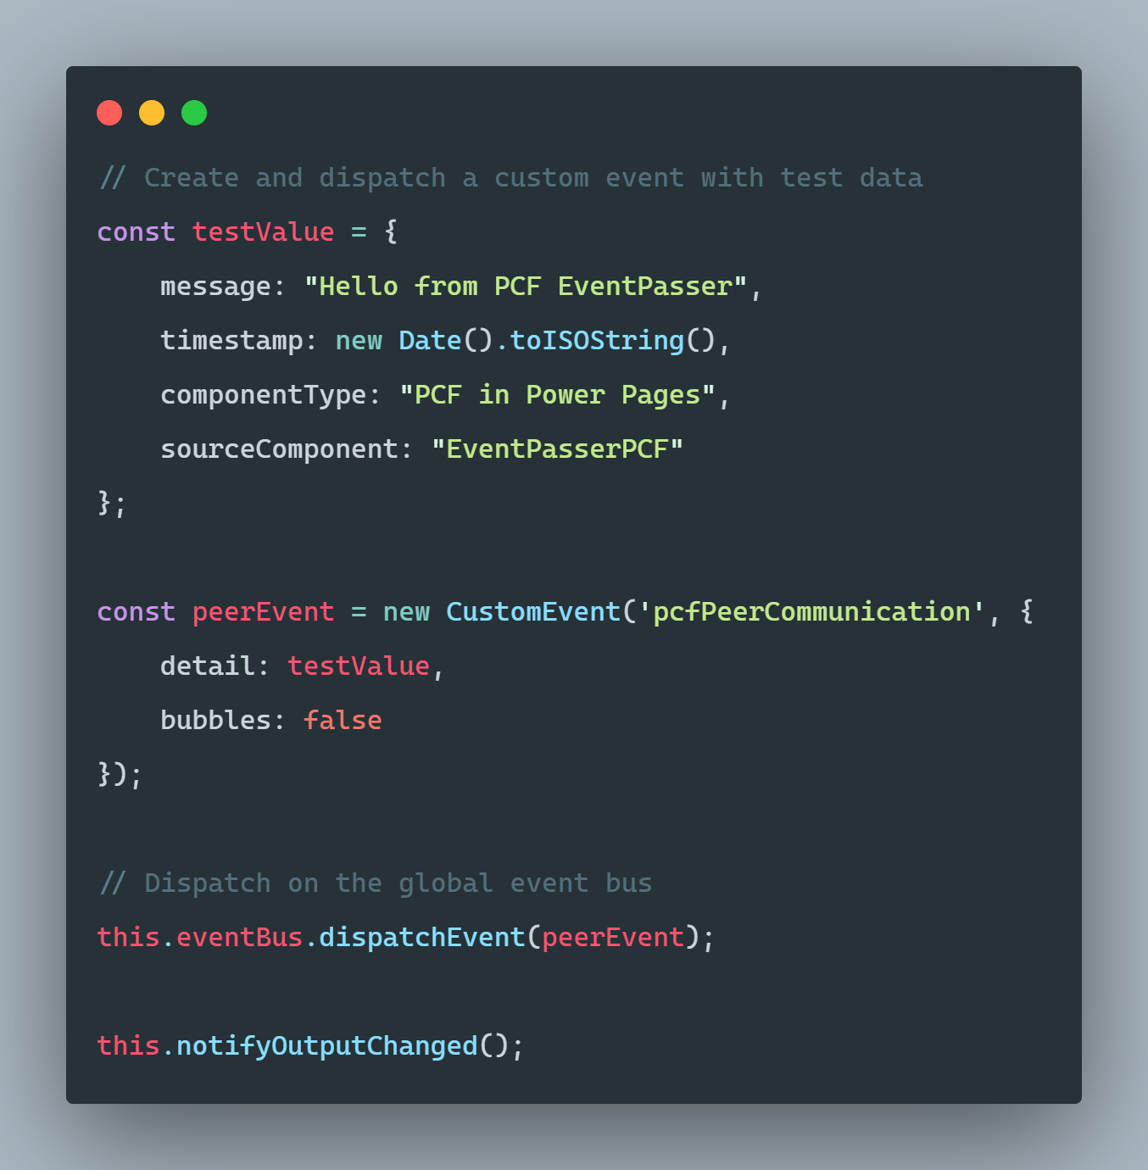

Slide 56
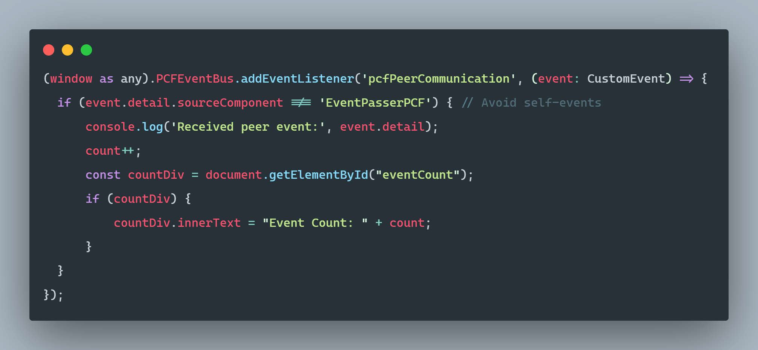

Slide 57
DEMO

Slide 58
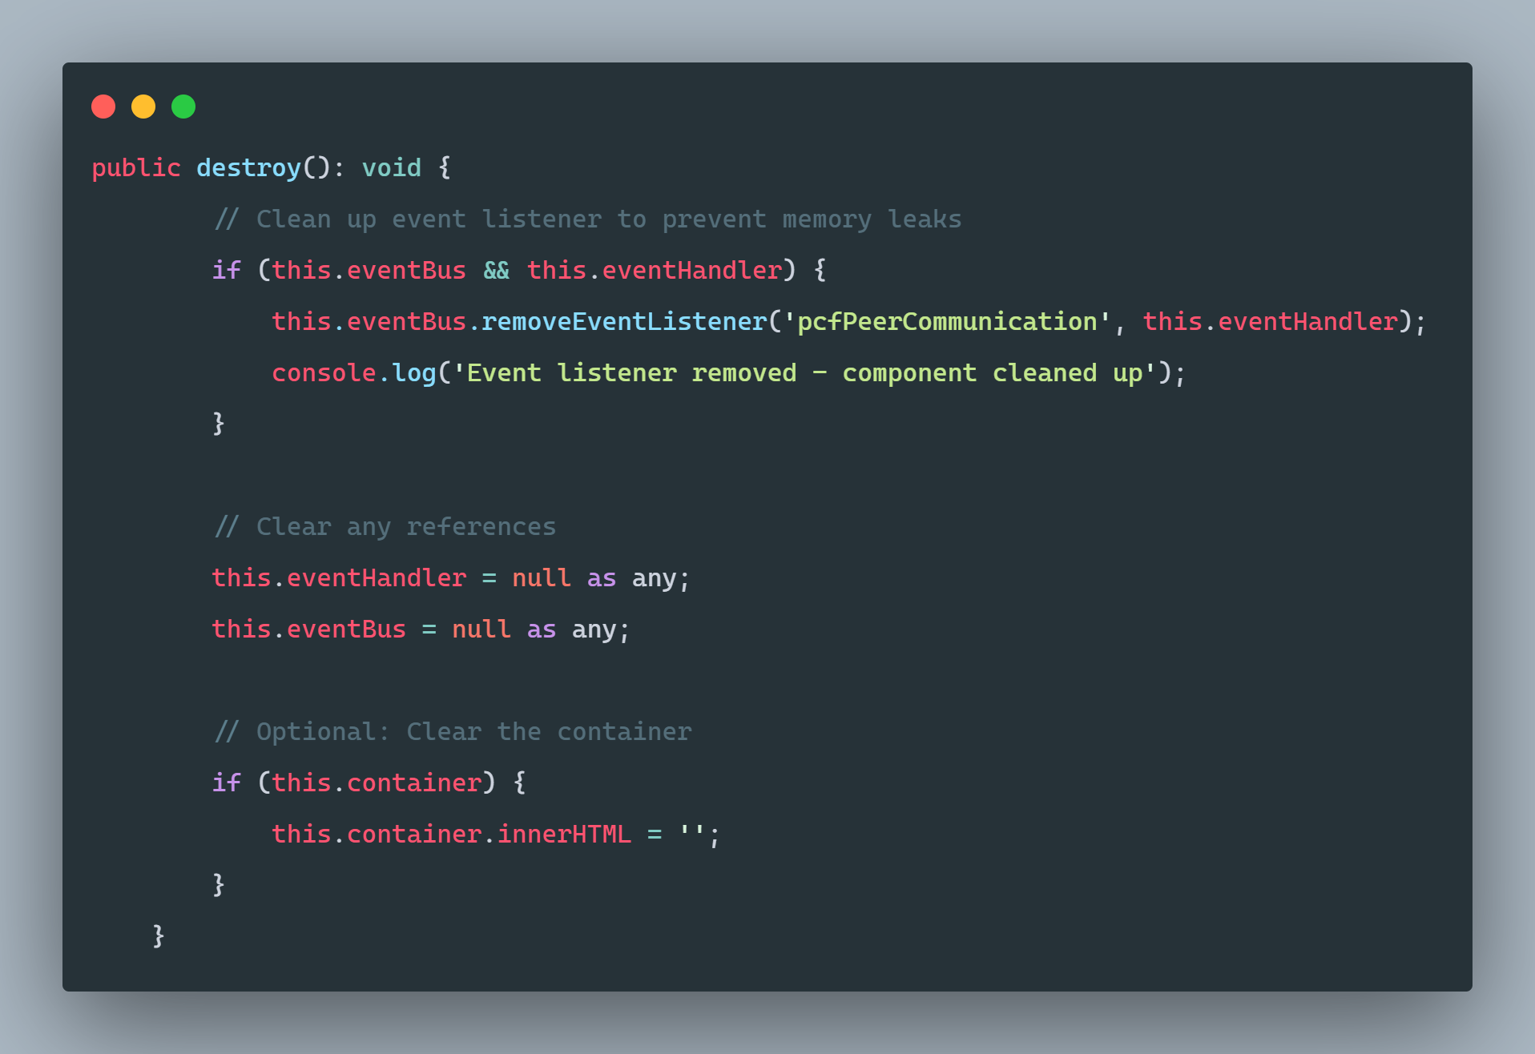
PERFORMANCE OPTIMIZATION
SAMPLE CODE: MEMORY PROTECTION AND GOOD HYGIENE
Notes:
Why the destroy method matters:
Prevent Memory Leaks: Event listeners that aren't removed will persist even after the component is destroyed
Multiple Instances: If the component is destroyed and recreated, you'd have duplicate listeners
Performance: Cleanup ensures resources are properly released

Slide 59
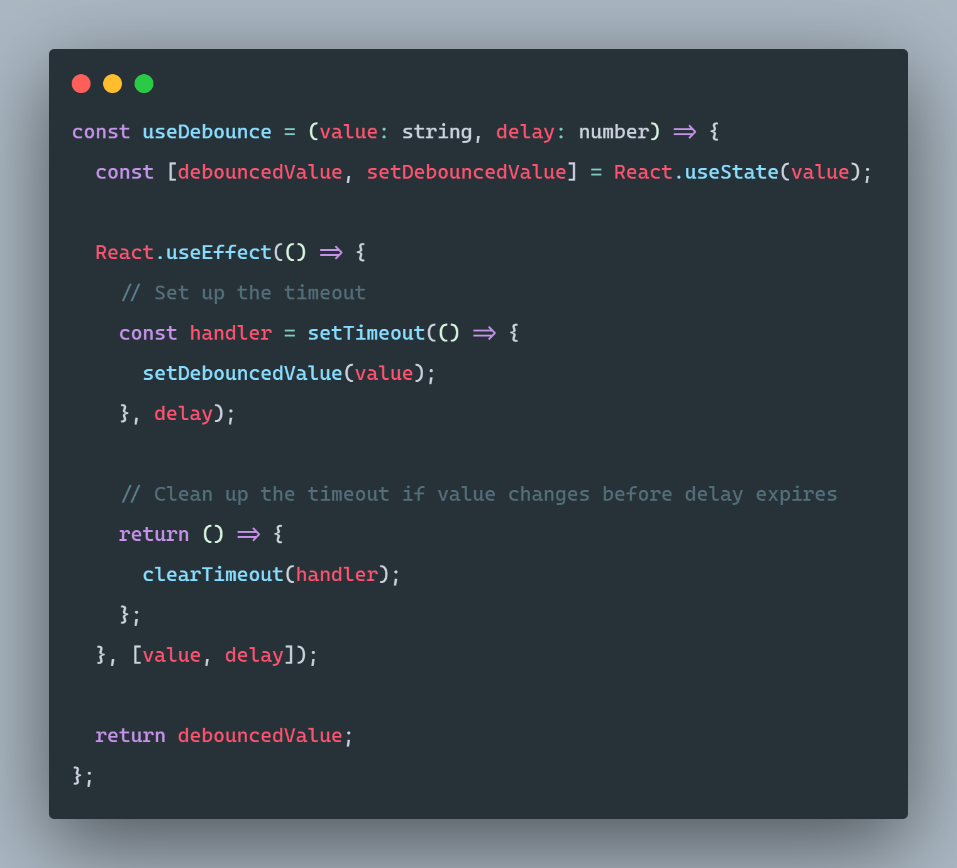
SAMPLE CODE: DEBOUNCER

Slide 60
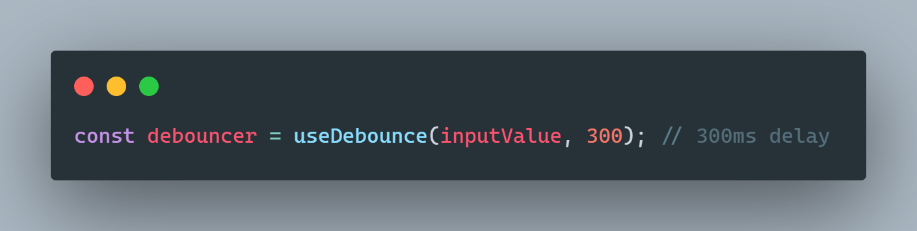

Slide 61
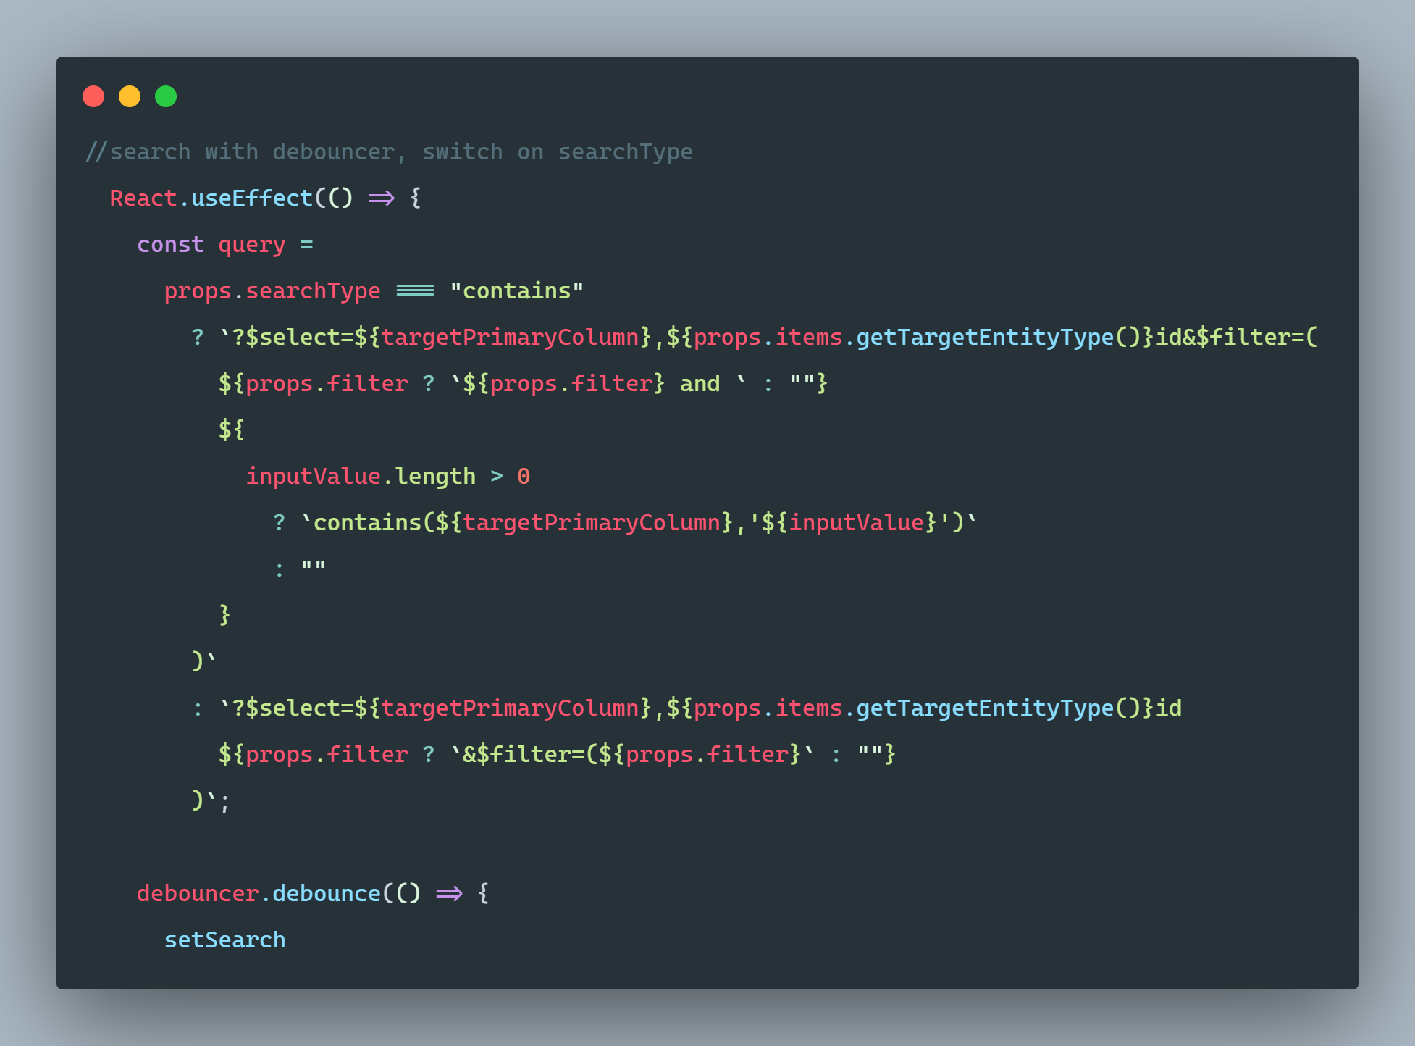

Slide 62
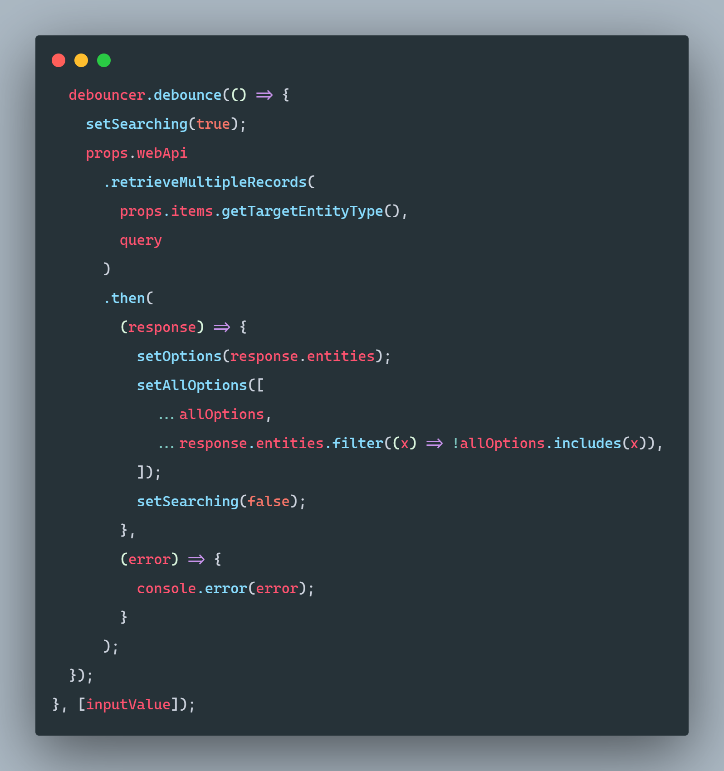

Slide 63
DEMO

Slide 64
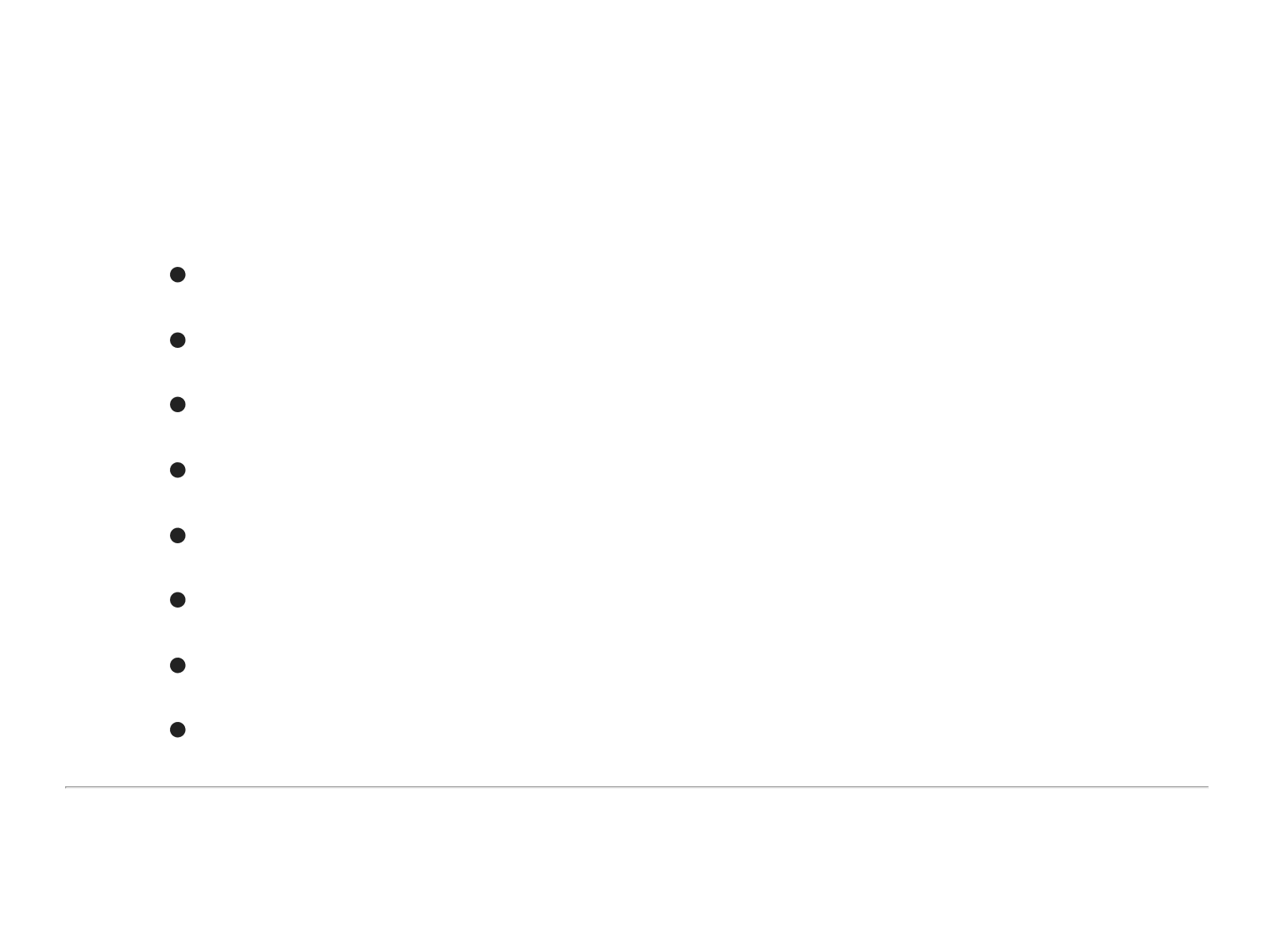
RESOURCES
Microsoft PCF documentation
Microsoft PCF tutorial
execute()
executeMultiple()
dispatchEvent()
Carl de Souza blog post
Power Pro Dev YouTube (shameless plug!) Our repository

Slide 65

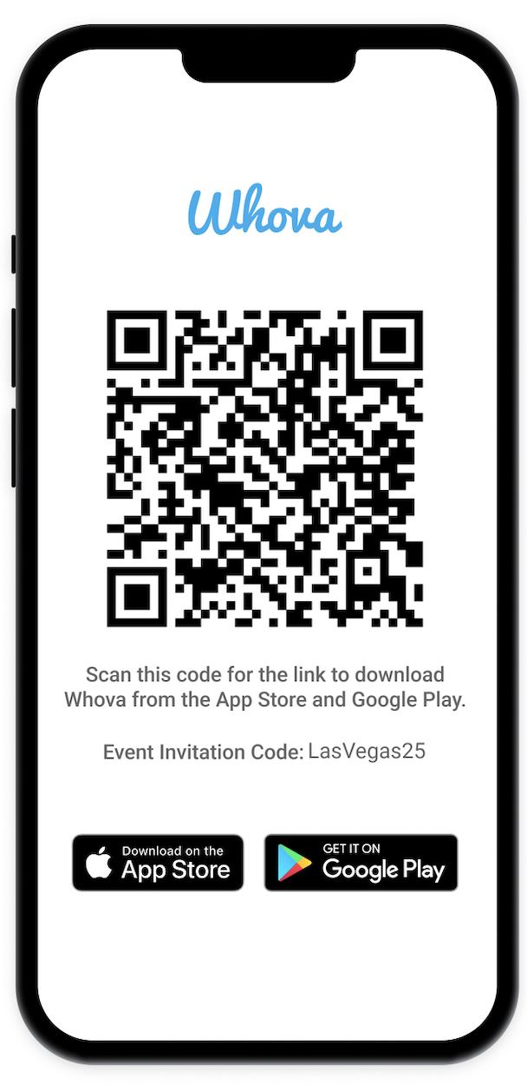
Join us on the app!
STAY IN THE KNOW
Receive event updates and notifications
Connect with other attendees
Personalize your agenda
Network & join meet-ups
Access to Event Documents
Having Trouble Joining?
Search for our event, Power Platform Community Conference.
Event Invitation Code: LasVegas25

Slide 66

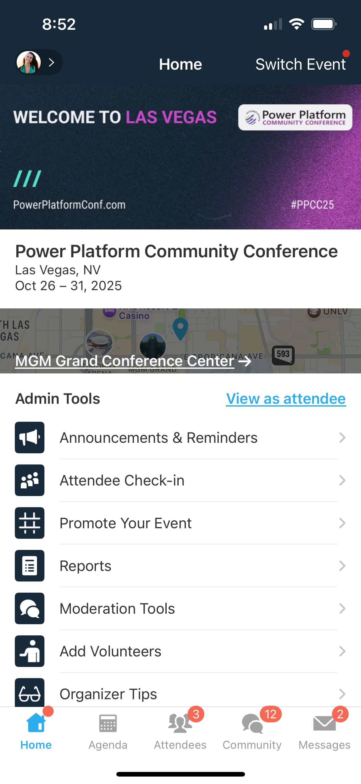
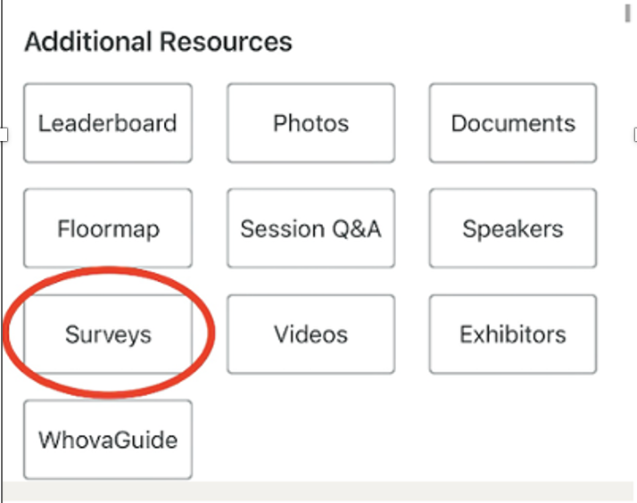
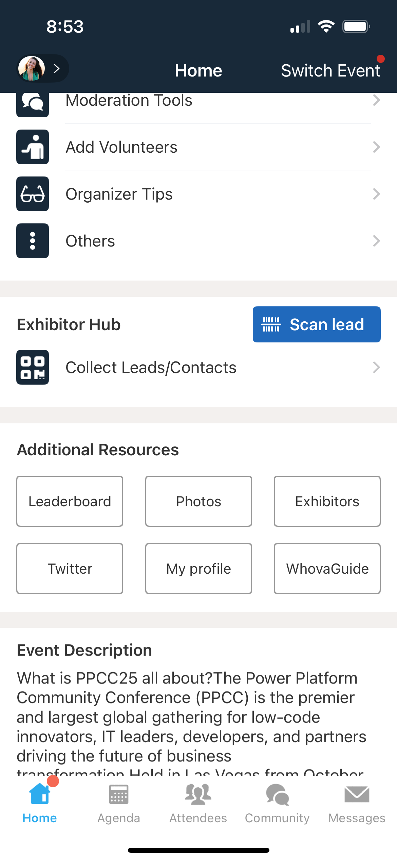
Session Feedback Surveys
We really want to hear from YOU!
In the pursuit of making next year’s Power Platform Community Conference even better, we want to hear your feedback about this session.
Here’s How -
Simply go to the Whova App on your smartphone
Scroll down on the Power Platform Community Conference Homepage to ‘Additional Resources’ to click “Surveys’.
Click Session Feedback.
Scroll down to find this session title.
Complete the session feedback survey.
Finally, click ‘Submit’
It’s just that easy!

Slide 67
Charles Channon and Garrett Pierce
Developers

